Slide 1
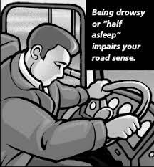
DRIVER DROWSINESS DETECTION SYSTEM
SAFEER SAIDHUMUHAMED

Slide 2
CONTENTS
ABSTRACT
BLOCK DIAGRAM
METHODOLOGY
IMPLEMENTATION
FUTURE ENHANCEMENTS
CONCLUSION

Slide 3
1. ABSTRACT
According to WHO, about 1.25 million people die globally each year due to road accidents. This figure is errored due to the under-reporting. Fatigue driving is one of the key causes of these accidents. India is one of the largest contributors to this number.
In order to overcome this problem, an intelligent system has to embedded in the vehicle itself to monitor the behavior of the driver and alert the driver if any of drowsiness symptoms are detected. A spectacle with eye blink and yawn sensor is used to detect the driver drowsiness and alerts the driver with buzzer, if driver is affected by drowsiness. To provide security to driver, the vehicles are assisted with automated safety system that alerts driver by using alarm . The system uses the device camera to detect eye blink and yawn.
The entire system is coded in python and uses various concepts of deep learning.

Slide 4
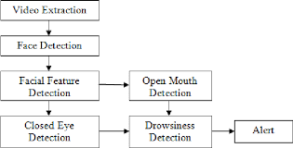
2. BLOCK DIAGRAM

Slide 5
3. METHODOLOGY
The basic drowsiness detection system has three blocks/modules : acquisition system, processing system and warning system. Here, the video of the driver’s frontal face is captured in acquisition system and transferred to the processing block where it is processed online to detect drowsiness. If drowsiness is detected, a warning or alarm is send to the driver from the warning system.
Data Acquisition
The video is live steaming using webcam and the frames are extracted and processed in a laptop. After extracting the frames, image processing techniques are applied on these 2D images.
Face Detection and Facial Landmarking
After extracting the frames, first the human faces are detected. After detecting the face, the next task is to find the locations of different facial features like the corners of the eyes and mouth. Prior to that, the face images should be normalized in order to reduce the effect of distance from the camera, non-uniform illumination and varying image resolution.
After image normalization, ensemble of regression trees is used to estimate the landmark positions on face from a sparse subset of pixel intensities. Using this method, the boundary points of eyes, mouth and the central line of the nose are marked and the number of points for eye, mouth are given.

Slide 6
Feature Extraction
After detecting the facial landmarks, the features are computed . The eye aspect ratio (EAR) is calculated from the ratio of height and width of the eye . EAR values indicate the drowsiness of the driver as eye blinks occur due to drowsiness. Mouth opening ratio (MOR) is a parameter to detect yawning during drowsiness. As defined, it increases rapidly when mouth opens due to yawning and remains at that high value for a while due to yawn (indicating that the mouth is open) and again decreases rapidly towards zero. As yawn is one of the characteristics of drowsiness, MOR gives a measure regarding driver drowsiness
Classification
After computing all the three features, the next task is to detect drowsiness in the extracted frames. Machine learning algorithms are used to classify the data. A threshold value is set for both EAR and MOR prior to image capturing. The values are then compared with the threshold value to classify whether it’s a blink or a yawn.

Slide 7
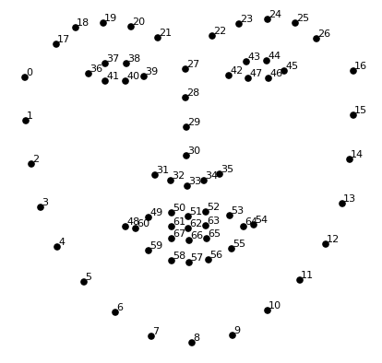
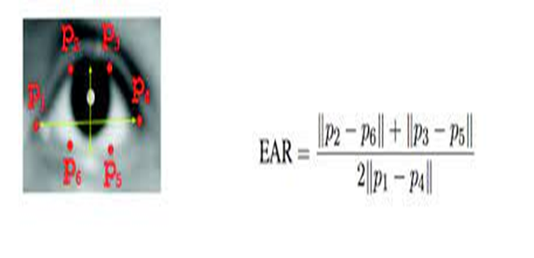
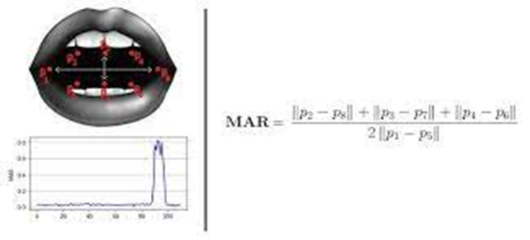
4. IMPLEMENTATION
The main idea of this project is to detect drowsiness . In other words to detect eye blinks and yawns to decide about drowsiness . It uses the system camera to capture live video . Dlib library is used for detecting faces and predicting facial landmarks of a person.
Using these facial landmarks eyes and lips are detected and the coordinates are saved. Then using these values eye aspect ratio(EAR) and mouth aspect ratio(MAR) are calculated .

Slide 8
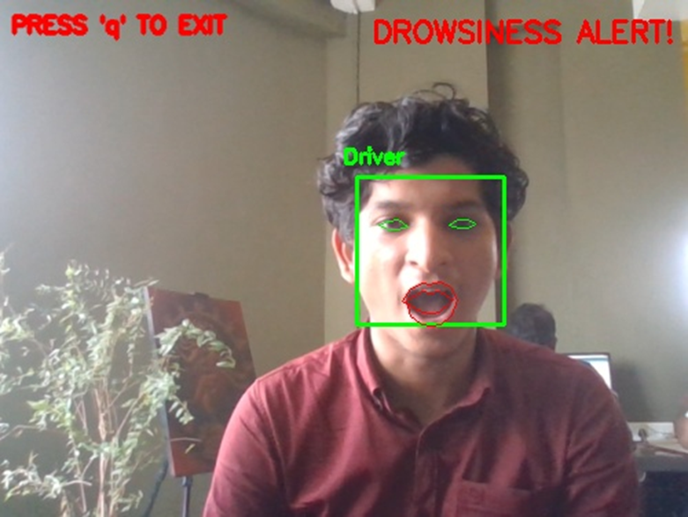
After obtaining both EAR and MAR these are compared with the threshold values. If EAR is less than the threshold value then it’s a blink. Similarly if MAR is greater than the threshold value it’s a yawn.
By combining both the above result it is decided if there is drowsiness or not. If drowsiness is detected then an alarm is sounded to alert.

Slide 9
5. FUTURE ENHANCEMENTS
The main goal of this project is to develop a simulation system that can detect drowsiness using a webcam. The system must meet certain requirement which is detecting drowsiness throughout the video frames. Thus, the driver can avoid accident. Secondly, it has to detect only drowsiness signs so that the system will not misinterpret any random signs that it received from the driver.
The system can be further improved by adding a 3-D face scanner. A 3-D scanner helps in easier detection of facial expressions . Also deploying a self learning machine to measure the threshold value would be highly efficient. The threshold value will be different for each individual. Hence, if the machine detects the threshold value of the driver by analysis, the system would be more suitable for every individual.

Slide 10
6. CONCLUSION
The system can be a highly efficient system to monitor fatigue level in a driver and can dominate over disadvantages from previously developed methods by using both eye and mouth feature set and also with a vast pool of data. This system requires only a camera to monitor the driver's face, therefore reducing its hardware cost.
This system works only on the required part of face image i.e. eyes and mouth, rejects the rest. This step decreases the unnecessary features in the feature set. Eye and mouth detection is less accurate than the face detection, that's why we use the face detection to get the eye and mouth image part of the driver. It makes the system optimized in the context of time and accuracy.

